Slide 1
Computer Vision Rubik’s Cube Solver
Daniela Tomás up202004946@edu.fc.up.pt
Diogo Nunes up202007895@edu.fc.up.pt

Slide 2
Introduction
We developed a Rubik’s cube solver that uses computer vision techniques to detect and analyze the colors on each face of the cube and then generate a sequence of moves to solve it. This presentation will provide an overview of the algorithms and processes used and discuss the results achieved.
Libraries used:
OpenCV: Well-known open-source computer vision library for processing images and videos. We used it for various image processing operations, including contour and edge detection, color range filtering, and rectangle drawing.
NumPy: Python library used for numerical operations. It was used for handling arrays and matrices.
Kociemba: Library for solving Rubik’s cubes. Given the cube's state, it can provide a sequence of movements to solve the puzzle.

Slide 3
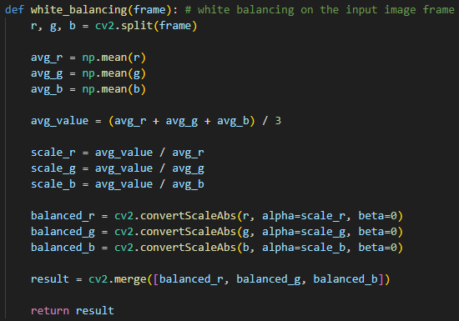
White Balancing
White balancing is a process in image processing that aims to adjust colors in an image to ensure that white objects appear white, regardless of the lighting conditions.
Fig.1 – White Balancing function.
Notes:
The code splits the input frame into Red, Green, and Blue color channels, calculates average values, determines a reference value, scales each channel's intensity, and merges them to create a balanced image.

Slide 4
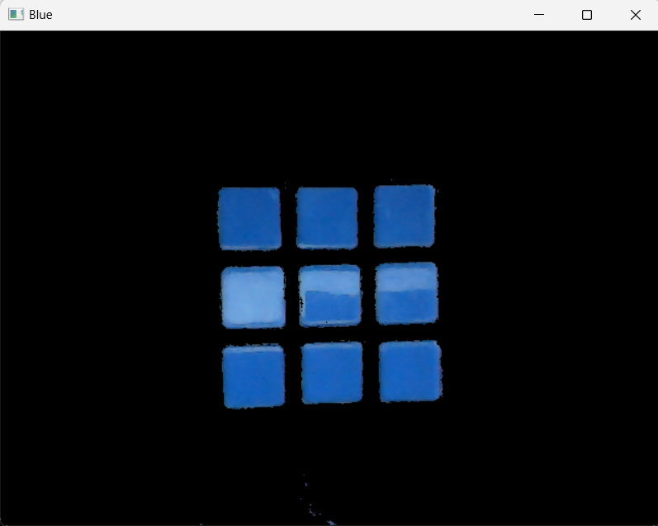
Color Detection
Blue
Green
White
Orange
Red
Yellow
HSV
(100-130, 100-255, 100-255)
(0-179, 0-50, 120-255)
(0/160-4/180, 100-255, 100-255)
(30-99, 100-255, 100-255)
(5-20, 100-255, 100-255)
(21-35, 100-255, 100-255)
Fig.2 - Set of HSV of color ranges used for each of the six colors on the Rubik’s cube.
Fig.3 – Blue mask.
Notes:
First, we made each color of the Rubik's cube have a color range in the HSV format (Fig. 1), which the program used to isolate the regions of the image most likely to contain Rubik's cube stickers of the desired color and produce a mask for each color.
Note: In Fig.1, the ranges represent the acceptable color values for detecting each face in an environment controlled by us. The values may vary due to different lighting conditions.

Slide 5
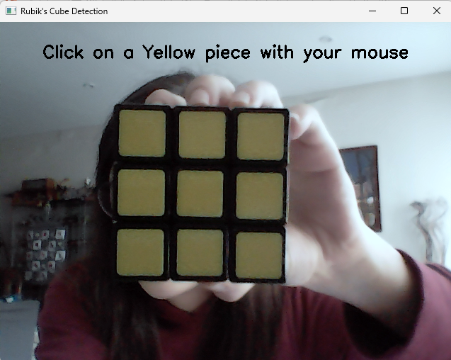
Color Detection
L*a*b*
Fig.4 – Colors calibration
Notes:
L – lightness
a – spectrum from green to red
b – spectrum from blue to yellow

Slide 6
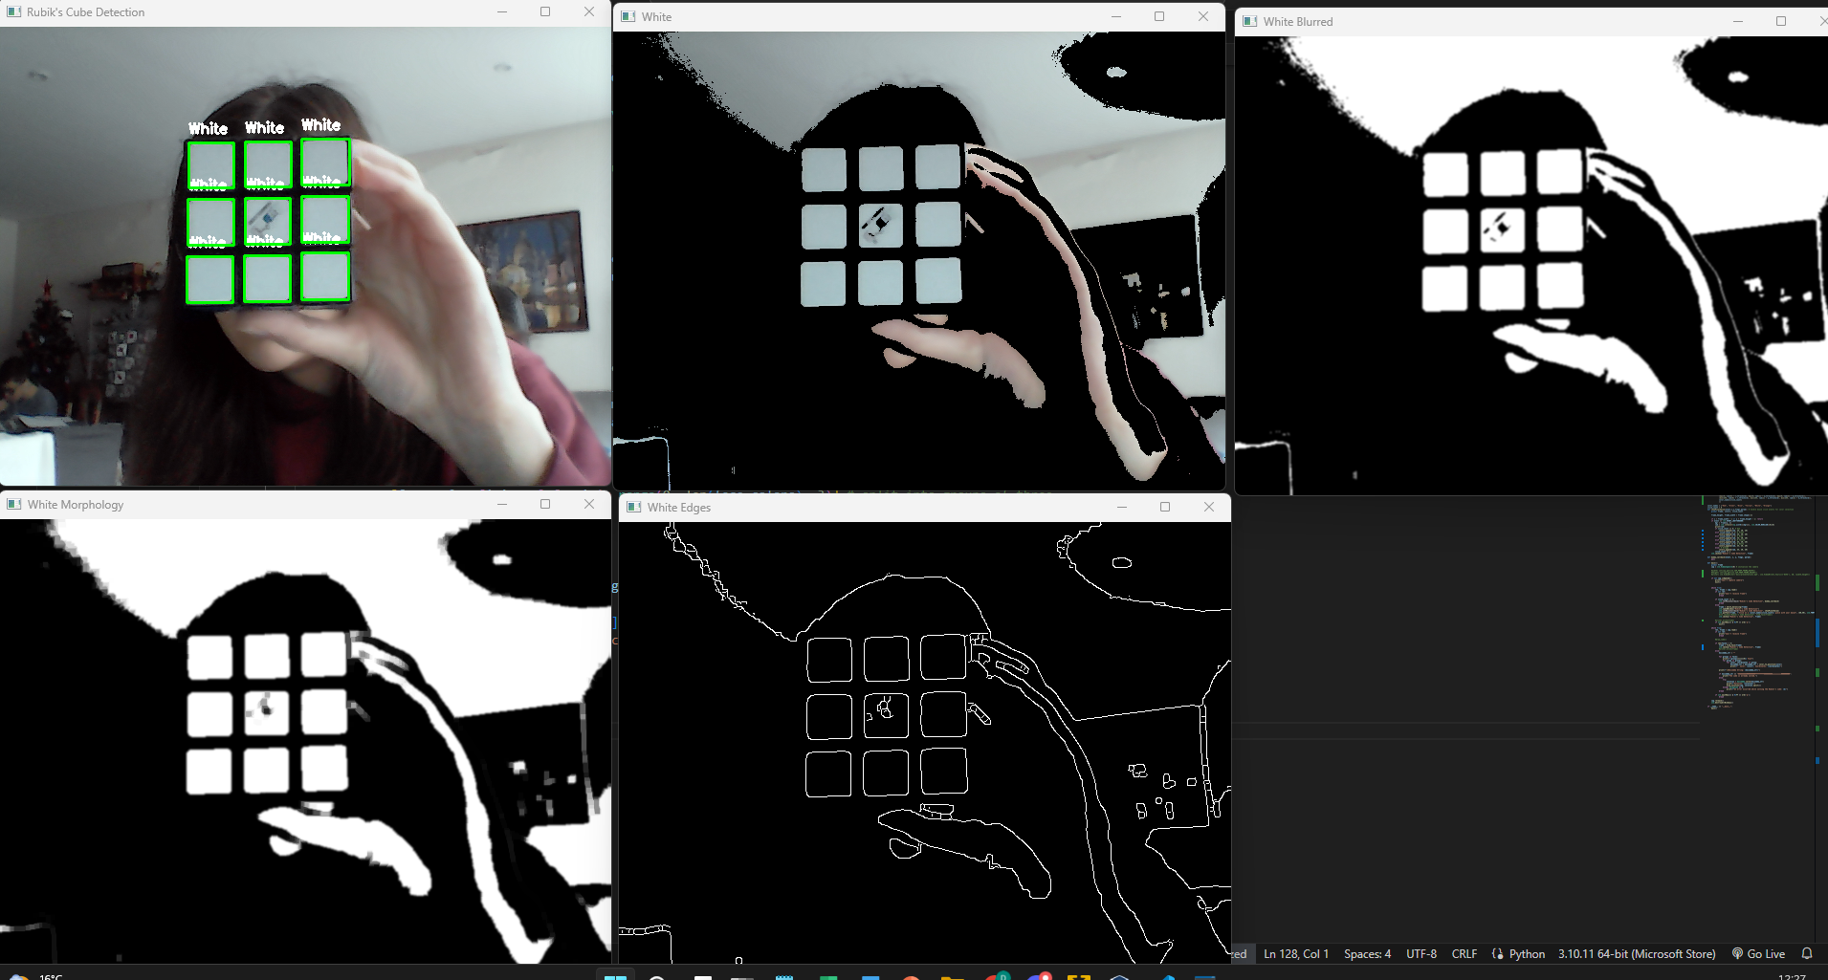
Processing Techniques
Fig.5 – Original frame
Fig.6 – Mask
Fig.7 – Gaussian Blur
Fig.8 – Morphological Operations
Fig.9 – Canny Edge Detection
Notes:
To improve the accuracy of color detection, additional image processing techniques were applied to the mask, such as Gaussian blur, morphological operations, and edge detection.
Gaussian Blur: Applied to reduce noise and smoothen the image. It's useful before edge detection to minimize high-frequency components.
cv2.morphologyEx is used for:
opening (erosion followed by dilation): helps to remove objects or noise from the foreground (bright regions)
closing (dilation followed by erosion): helps to close small holes or gaps in the foreground
The cv2.Canny function is used to detect edges in the frame.

Slide 7
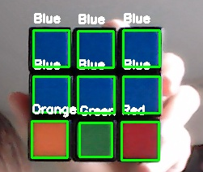
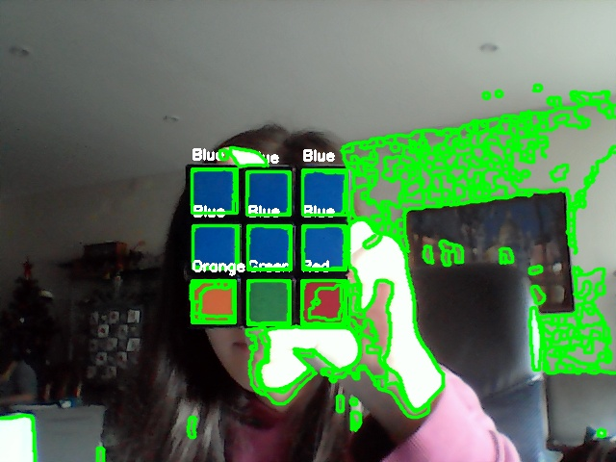
Square Detection
To be considered a square and distinguish Rubik’s cube stickers from other objects in the frame, a contour must satisfy the following conditions:
The contour must have four vertices;
The aspect ratio is close to 1;
Contours with areas that fall within a specific range are considered.
(289, 103)
(344, 104)
(400, 103)
(289, 160)
(400, 160)
(344, 160)
(287, 215)
(346, 217)
(398, 216)
Fig.9 – Nine squares detected in a single frame.
Fig.8 – Contour Detection
Notes:
If a square is detected, the program draws a bounding rectangle around it and annotates it with the color's name in real time.
If 9 squares are detected in a frame (Fig.3), they are sorted by their y-coordinates, grouped into sets of three (representing a row of the Rubik’s cube), and then sorted by their x-coordinates to create a face.

Slide 8
Kociemba Algorithm
When all the 6 faces are detected, the program generate a Kociemba string representing the color configuration of the entire Rubik’s cube.
Solved Rubik’s cube string:
“UUUUUUUUURRRRRRRRRFFFFFFFFFDDDDDDDDDLLLLLLLLLBBBBBBBBB“
Example:
>> kociemba.solve('DRLUUBFBRBLURRLRUBLRDDFDLFUFUFFDBRDUBRUFLLFDDBFLUBLRBD’)
u"D2 R' D' F2 B D R2 D2 R' F2 D' F2 U' B2 L2 U2 D R2 U"
D
U
U
R
U
U
F
U
L
L
U
U
U
L
B
B
U
F
U
U
R
R
R
L
F
U
R
D
D
B
L
F
F
R
R
F
R
F
R
B
L
D
R
B
F
F
R
R
F
U
F
R
U
R
F
R
D

Slide 9
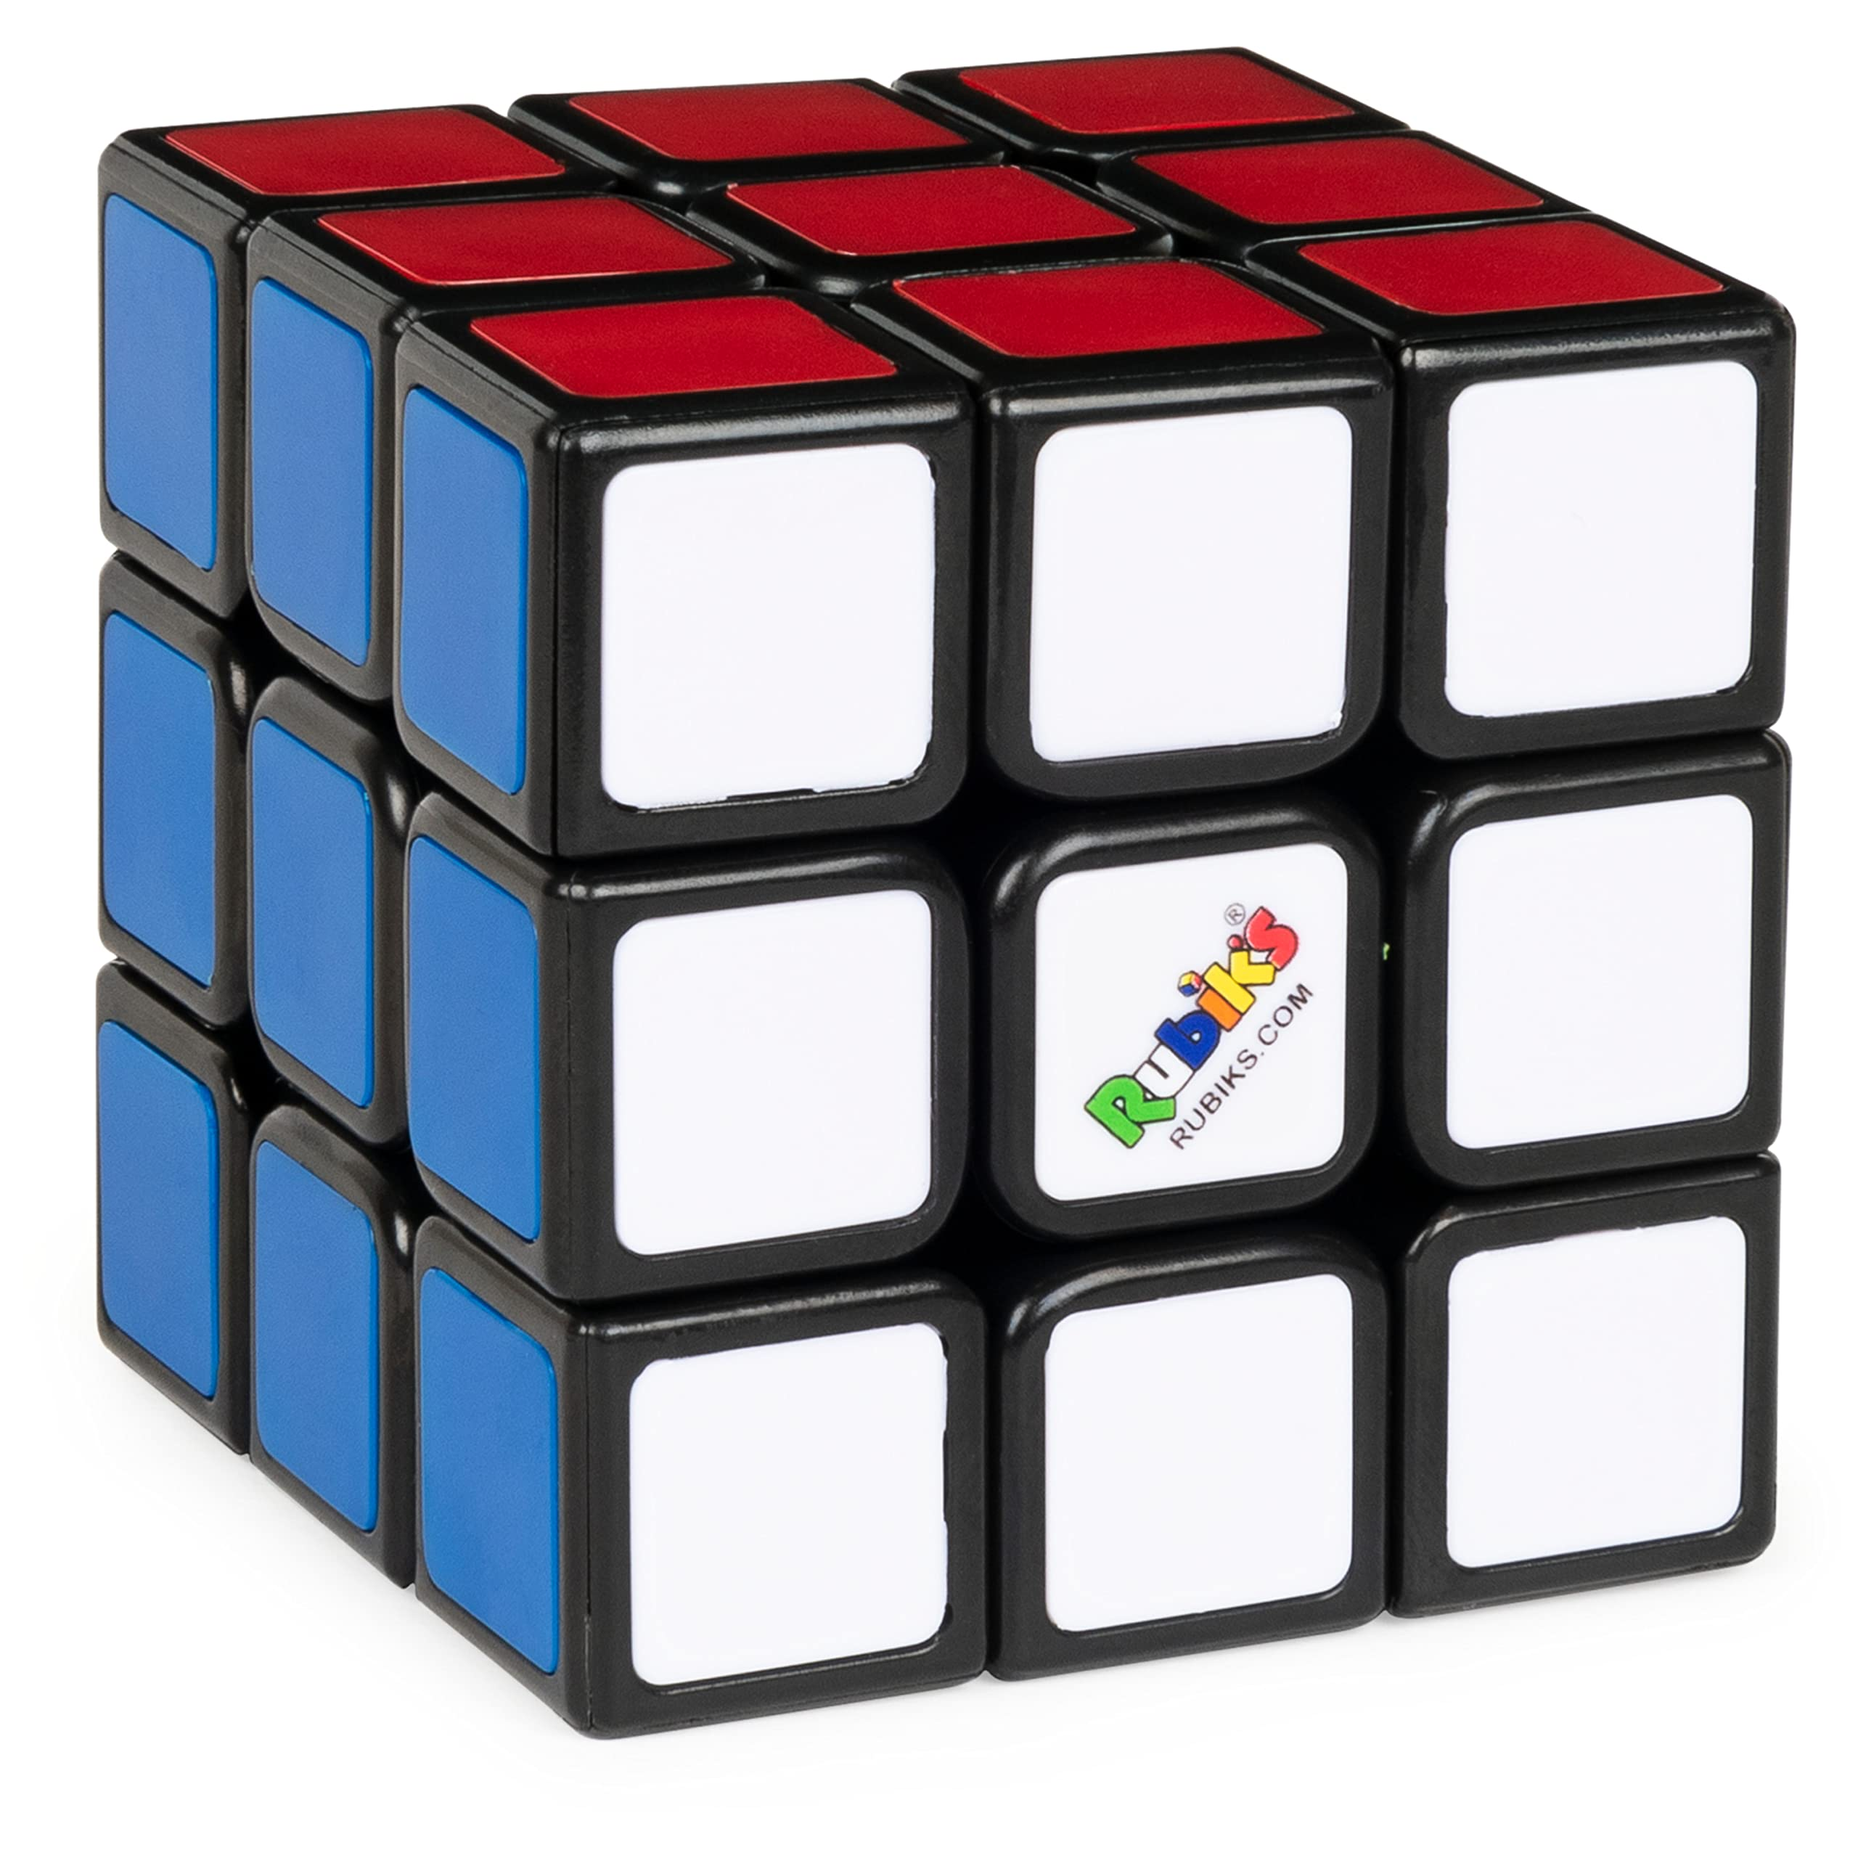
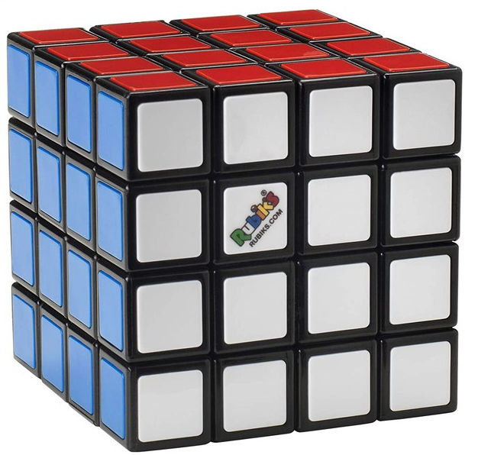
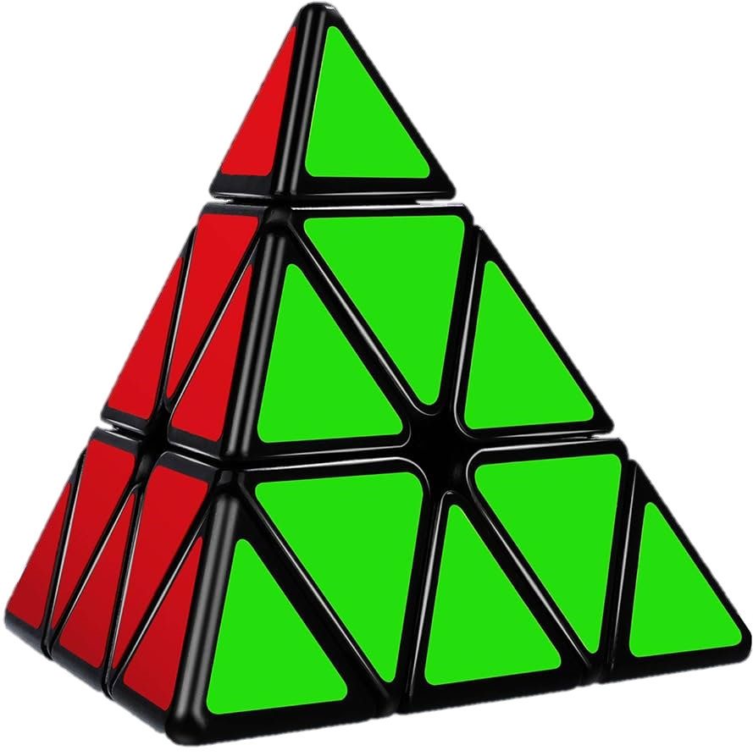
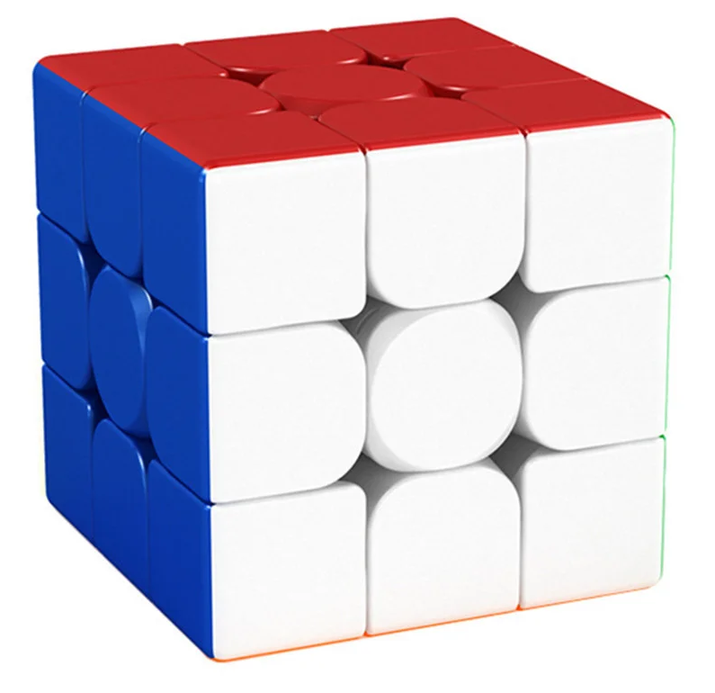
Conclusion
The computer's vision Rubik’s cube solver hasn’t been implemented the way we wanted.
Future work could include improving the detection of cubes other than Rubik’s brand and even extending our system to solve larger cubes. We could also use techniques for 3D reconstruction and automatic color range adjustment to improve adaptability to different lighting environments. Another point for improvement would be the user interface for a more intuitive experience.

